Slide 1
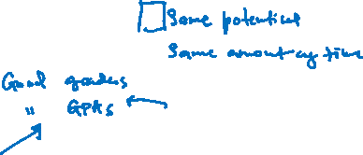
Time Management
Prof. Koliya Pulasinghe

Slide 2
Agenda
Time Management: What? Why?
Tracking Your Time
Goal Setting and Structuring Time
Planning for the Semester
the Week
the Day
Stress Reduction Tips
2
Notes:
2

Slide 3
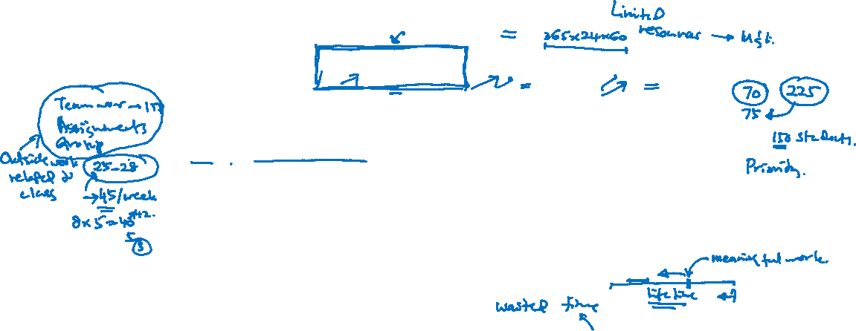
Time Management
Balancing Academic, Family & Social Life
Less in-class time and more outside work related to class work
To complete all tasks on time with minimum personal stress
3
Notes:
3
Area that lecturer is covering, You can see the text book,

Slide 4
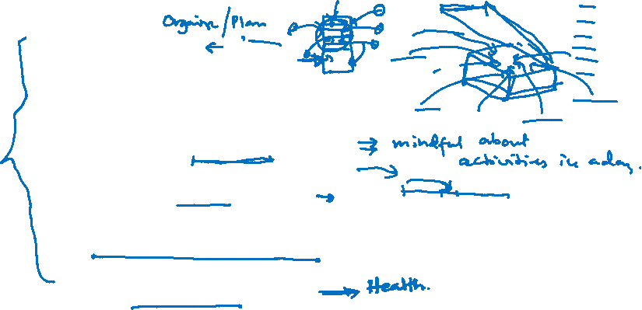
Advantageous of Time Management
gain time
motivates and initiates
reduces avoidance
promotes review
eliminates cramming
reduces anxiety
4
Notes:
4
Planning has to be reviewed, daily, weekly and annually. Drawbacks should be identified and rectified.

Slide 5
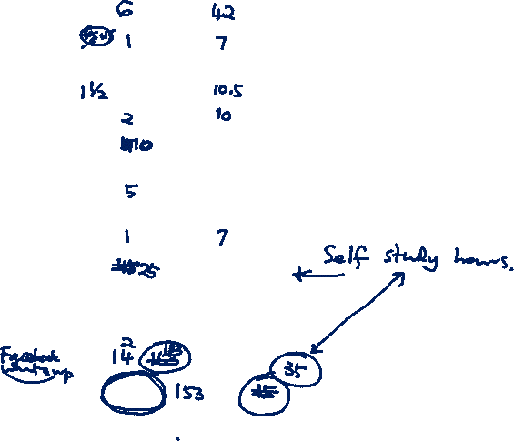
Task 1: Track Your Time
Number of hours of sleep each night __ X 7 = __
Number of grooming hours per day __ X 7 = __
Number of hours for meals/snacks per day - include preparation time __ X 7 = __
Total travel time weekdays __ X 5 = __
Total travel time weekends __
Number of hours per week for regularly scheduled functions (clubs, prayers, get-togethers, etc.) __
Number of hours per day for chores, errands, extra grooming, etc. __ X 7 = __
Number of hours of work per week __
Number of hours in class per week __
Number of average hours per week socializing, dates, etc. __
Now add up the totals: __
Subtract the above number from 168: 168 - ___ = ____
5
Notes:
5

Slide 6

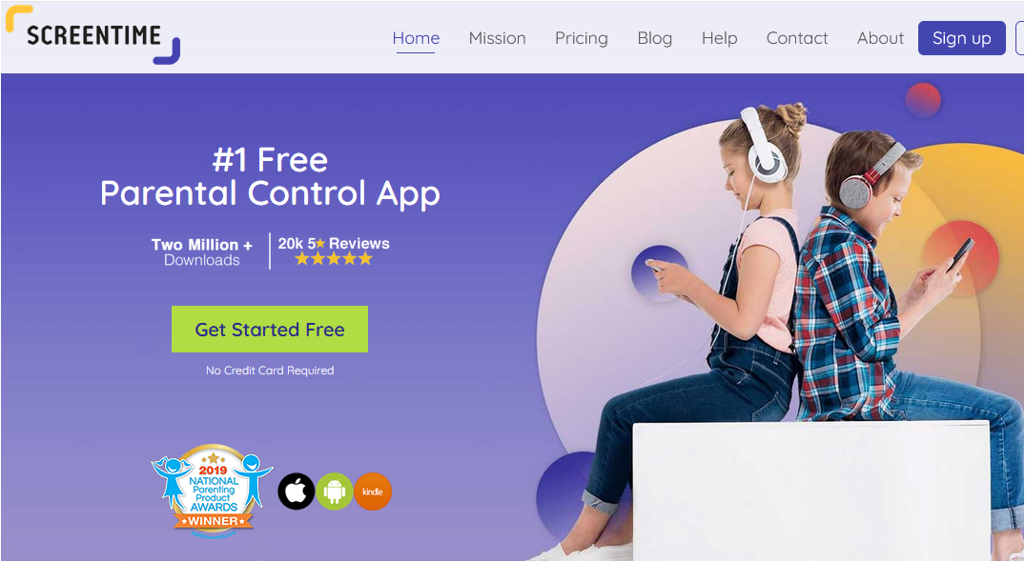
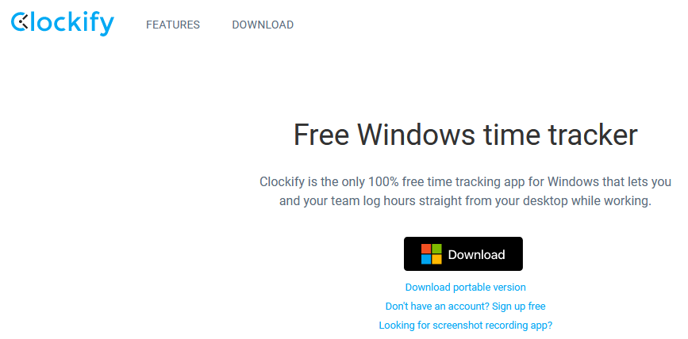

Task 1: Track Your Time
6
Notes:
6

Slide 7
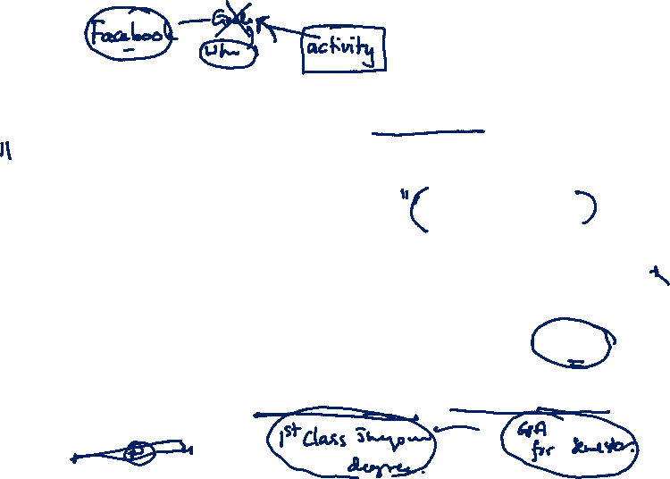
Motivation: Goal Setting
If you don’t know where you’re going you’ll end up somewhere else anonymous.
To be motivated, you need to have a goal
No one else can force you to become motivated; it has to come from you
Goals can be long-term, medium-term and short-term
Notes:
Motivation to do time management starts from goal setting

Slide 8
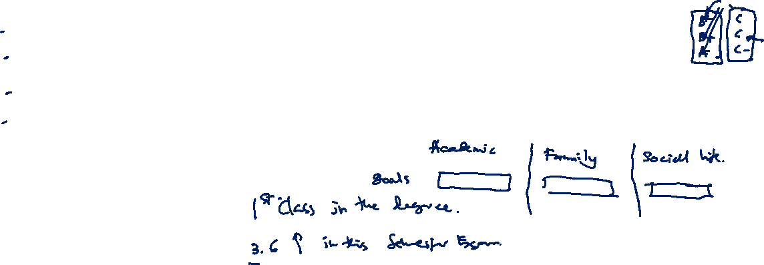
Example: Getting Better Grades
Grades tell “to what extent you achieved the knowledge and skills required” to be a graduate
GPA/Average reflects your academic performance
Good GPA/Average and soft skills make you a better graduate

Slide 9
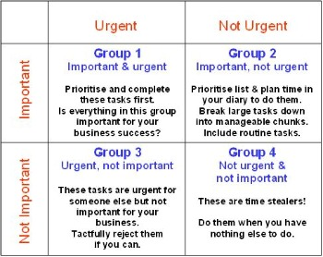
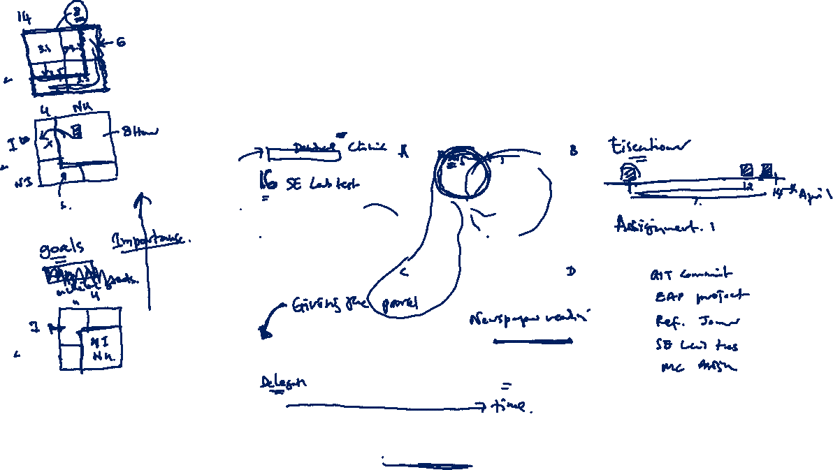
Structuring Your Time
Time Management Matrix: Adapted from “the 7 Habits of
Highly Effective People” by Stephen R. Covey
9
Notes:
9

Slide 10
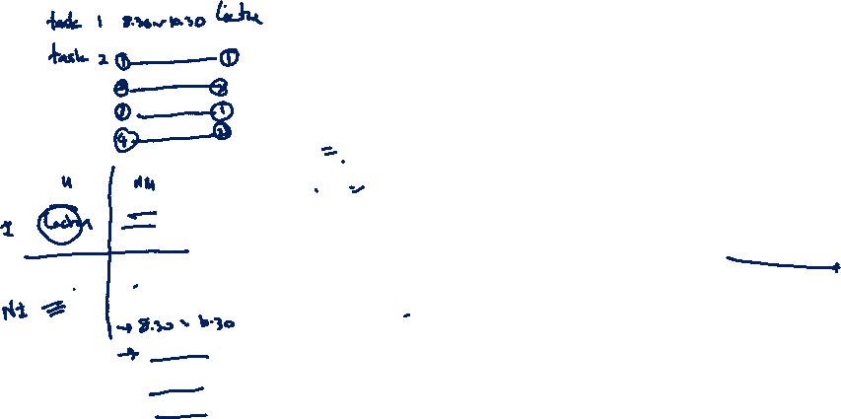
Structuring Your Time
Identify the tasks that have to be done
Rank these tasks
Sequence the work, giving a realistic allocation of time to each activity
Remember to allow time for social and personal commitments
Become aware of time-wasting activities and avoid them or keep them under control
Be realistic about how much you can achieve in each study session and remember to schedule short breaks every hour or so.
10
Notes:
10

Slide 11
Planning for the Semester
Check the SLIIT Calendar
Draw up a semester timetable
mark on your timetable dates when lectures and tutorial are held, tests are set, assignments are due, and any other significant events.
Devise a colour-coding system to avoid confusion
Overview of your commitments for the semester
Consider the study preparation time required for lectures, tutorials, tests, assignments and so on and indicate these on your timetable.
11
Notes:
11

Slide 12
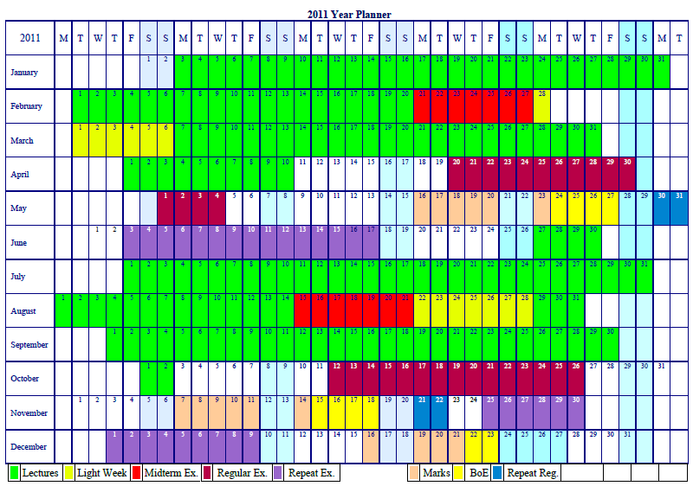

Year Plan

Slide 13
Planning for the Week
At the beginning of each week refer to your semester timetable and use this as the basis of your weekly plan
Make additional learning hours for easy class 2 hours, average class 3 hours, difficult class 4 hours
Example: Weekly Planner
13
Notes:
13
When to study and where to study

Slide 14
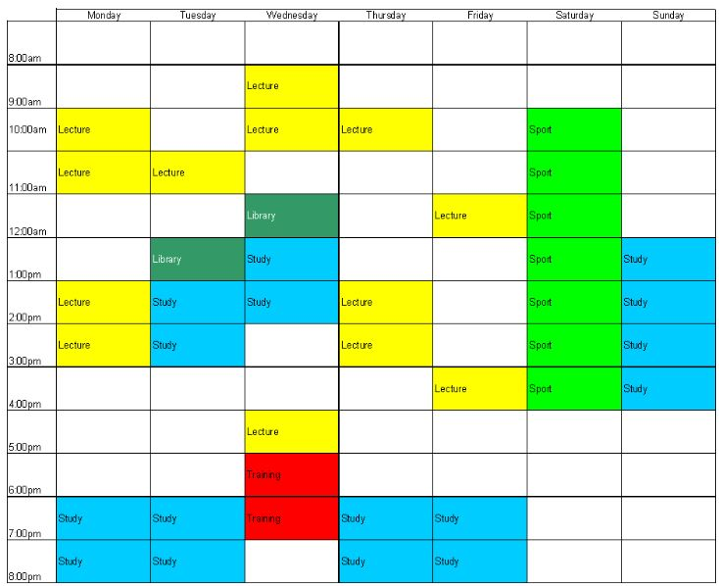
Weekly Plan

Slide 15
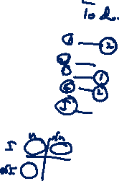
Planning for the Day
Make a to-do list for each day the night before or during breakfast
Include everything that needs to be done on the list, including homework, class assignments, shopping, laundry and even partying
Prioritize items
When you have completed one of the tasks on your list, cross it off
15
Notes:
15

Slide 16

Five Steps to Successful Time Management
Set specific academic and personal goals
Create a term calendar, recording major events
Create a weekly schedule of your classes, labs, drill, meetings, etc
Decide on specific times to work on each course
Make a to-do list for each day the night before or during breakfast
16
Notes:
16

Slide 17

Stress Reduction Tips
Find someone with whom you can talk
Gain temporary control of your anxiety by practicing relaxation techniques
Work on feeling better about yourself
Try replacing negative thinking with positive thoughts
In general, try being your own best friend
17
Notes:
17

Slide 18
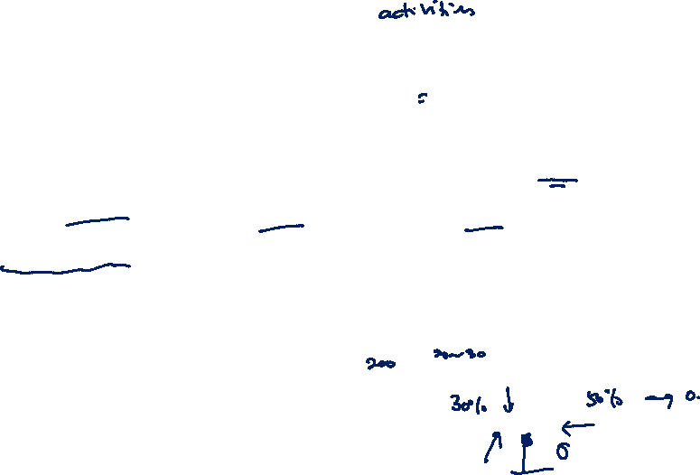
Exercise: Time Management
Complete Task 1. Suggest methods that you can use this time period (Covid-19 Break) to maximize your learning time
Write a reflective journal about an incident in your academic life (a disaster or a difficulty) you faced due to poor time management
Submit your assignment as a PDF on or before midnight 20th April, 2021.
18
Notes:
18

Slide 19
The bad news is time flies, The good news is you are the pilot -Michael Althsuler Thank You
19
Notes:
19

Slide 20
Thank You

